Slide 1
Optimizing Information Leakage in Multi-cloud Storage Services
Batch No: MP20CS09
B. Raman (160716733031)
B. Nandu (160716733032)
K. Gautham (160716733045)
Under the Guidance of
Mr .K. Uday Kumar
Assistant Professor
Department Of CSE
Project Coordinator
Mr. Sandeep Ravikanti
Assistant Professor
Department Of CSE
Methodist College of Engineering and Technology Department of CSE

Slide 2
Contents
Introduction
UML Diagram
Modules
Full Stack Technology
References
Methodist College of Engineering and Technology Department of CSE

Slide 3
Introduction
Centralized cloud storage services are criticized for grabbing the control of users data, which allows storage providers to run analytics for marketing and advertising.
Also the information in users data can be leaked. In our project the possible solution to reduce the risk of information leakage is to employ multicloud storage systems in which no single point of attack can leak all the information.
Methodist College of Engineering and Technology Department of CSE

Slide 4
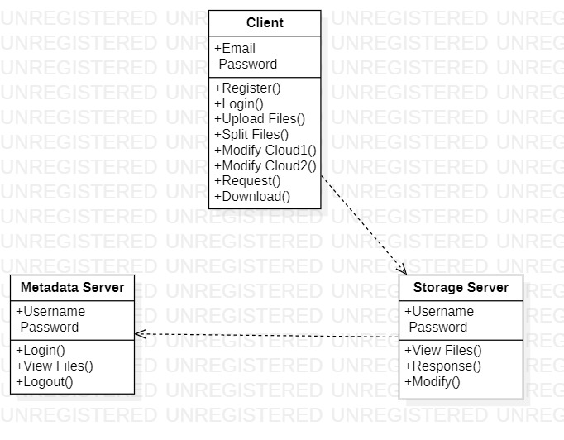
UML Diagrams
Class diagram
Methodist College of Engineering and Technology Department of CSE

Slide 5
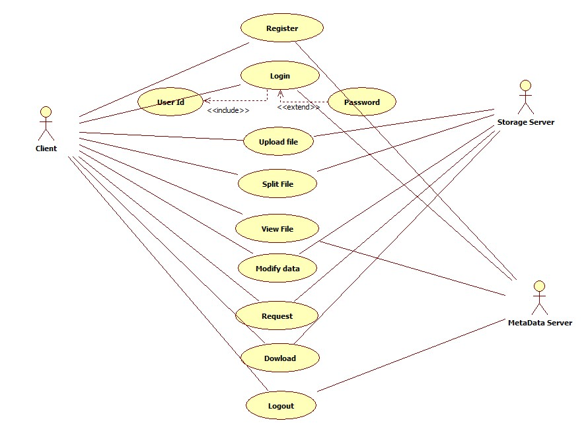
Use-Case diagram
Methodist College of Engineering and Technology
Department of CSE

Slide 6
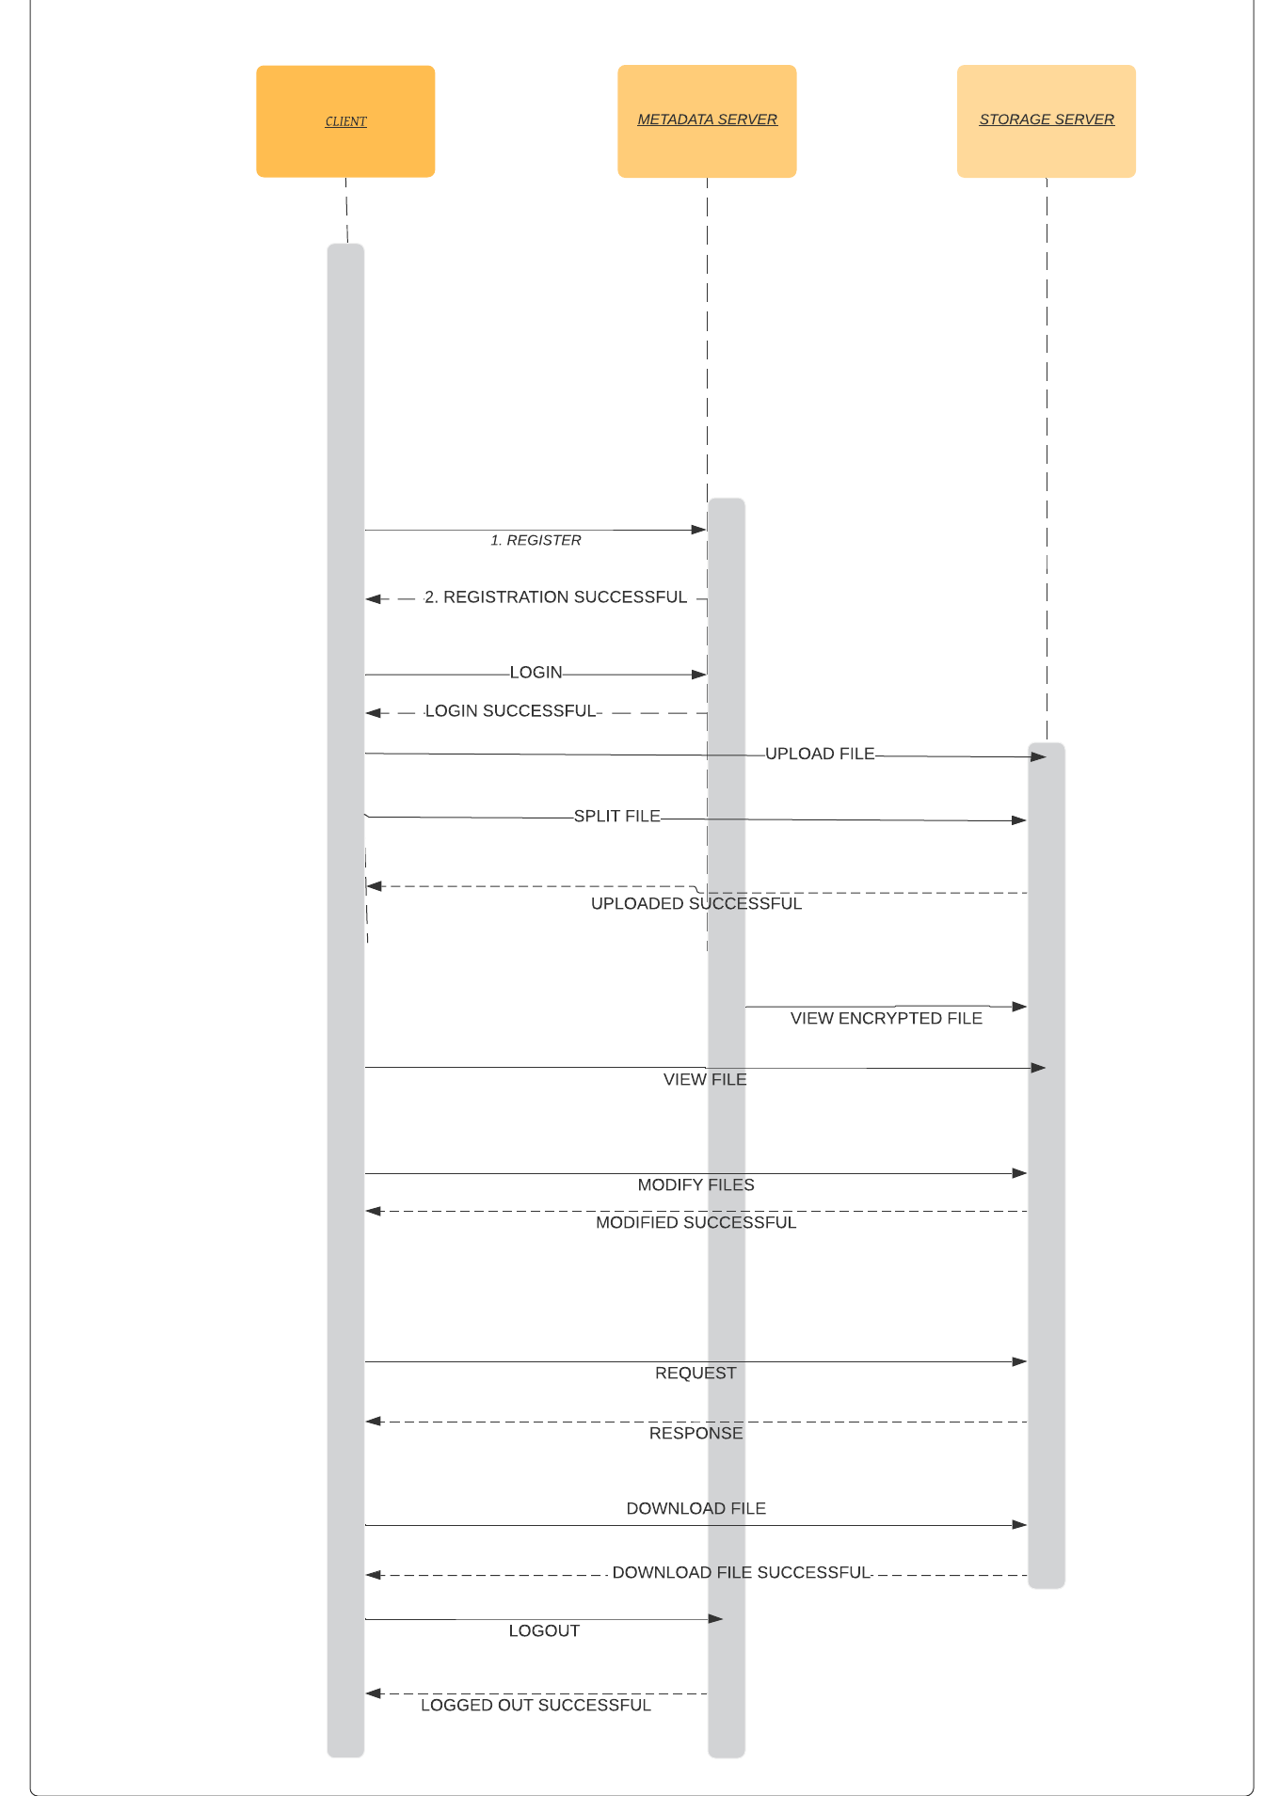
Methodist College of Engineering and Technology
Department of CSE
Sequence diagram

Slide 7
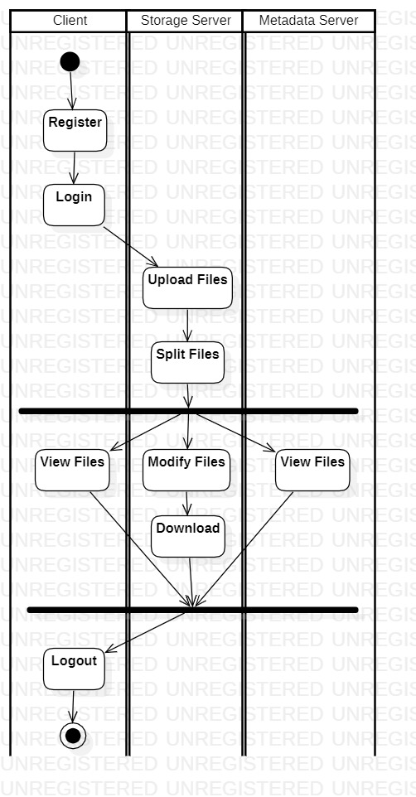
Methodist College of Engineering and Technology
Department of CSE
Activity diagram

Slide 8
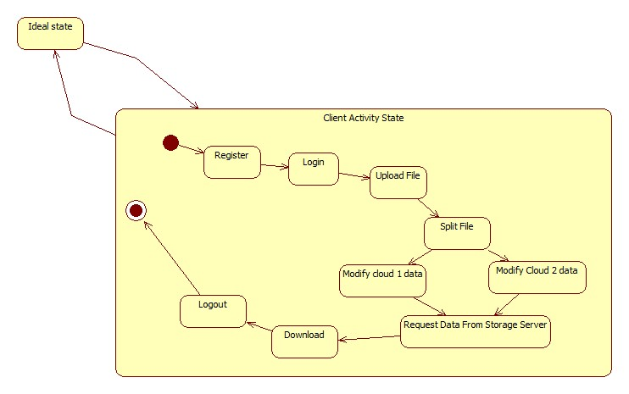
Methodist College of Engineering and Technology
Department of CSE
State Chart Diagram

Slide 9
Modules
DATA OWNER
METADATA SERVER
CLOUD SERVICE PROVIDER
DATA USER
Methodist College of Engineering and Technology Department of CSE

Slide 10
DATA OWNER
In this module, we develop the Customer features functionalities. Customer first register user details and login. Customer can outsource sensitive and valuable data to cloud by encrypting data and splitting data in to multiple parts.
METADATA SERVER
Metadata servers are used to store the metadata database about the information of files, CSPs and users,which usually are structured data representing the whole cloud file system.
Methodist College of Engineering and Technology Department of CSE

Slide 11
CLOUD SERVICE PROVIDER
In this module, we design the Cloud functionalities. The Cloud entity can view all customer details, file upload details and customer file download details. In this module, we use the DriveHQ Cloud Service API for the Cloud Integration and develop the project.
DATA USER
Data user module is used to check user data download by requesting file from cloud.The read routine fetches the stored value from the servers.
Methodist College of Engineering and Technology Department of CSE

Slide 12
Full Stack Technology
Operating System : Windows 7 & above
User Interface : HTML, CSS
Programming Language : Java
IDE/Workbench : NetBeans 7.4
RAM : 1GB Minimum
Database : MySQL
Methodist College of Engineering and Technology Department of CSE

Slide 13
References
[1] UML Distilled : A Brief Guide to the Standard Object Modeling Language By Martin Fowler.
[2] Cloud Computing : Principles and Paradigms By Rajkummar Buyya.
[3] JAVA : The Complete Reference By Herber Schildt.
Methodist College of Engineering and Technology Department of CSE

Slide 14
Thank You

